Slide 1
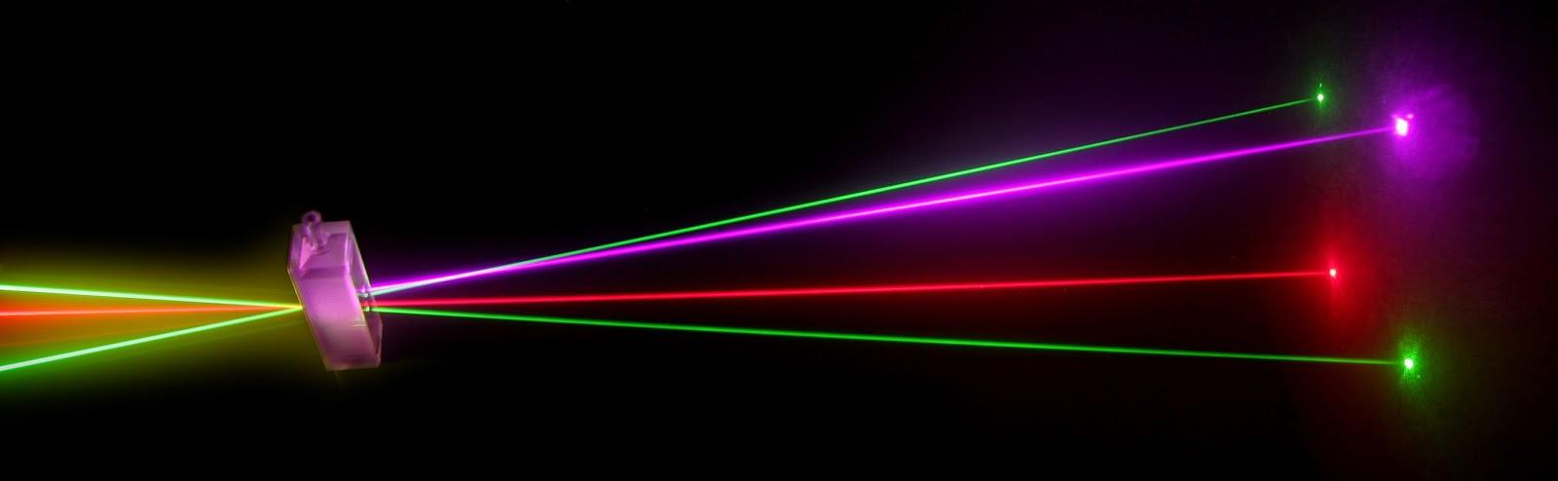
“Laser Technology and Applications” 16B1NPH533 Lecture 14

Slide 2
Lecture 14 Content Outlines
Laser Rate Equations
The Four-Level Laser System
Lasers fundamentals and applications by K. Thyagarajan, Ajoy Ghatak
Chapter 5 Laser Rate Equations

Slide 3
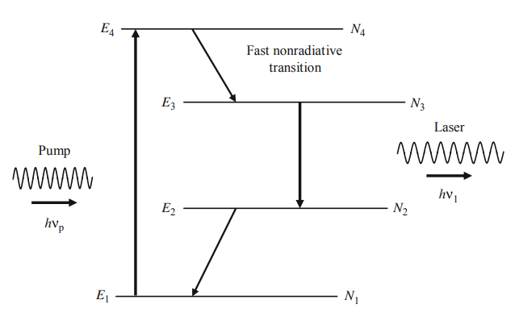
Level 1 is the ground level and levels 2, 3, and 4 are excited levels of the system. Atoms from level 1 are pumped to level 4 from where they make a fast nonradiative relaxation to level 3 (Metasatable level having a long lifetime) .The transition from level 3 to level 2 forms the laser transition. In order that atoms do not accumulate in level 2 , level 2 must have a very small lifetime so that atoms from level 2 are quickly removed to level 1 ready for pumping to level 4. If the relaxation rate of atoms from level 2 to level 1 is faster than the rate of arrival of atoms to level 2 then one can obtain population inversion between levels 3 and 2 even for very small pump powers. Level 4 can be a broad level so that optical pump source emitting over a broad range of frequencies can be used to pump atoms from level 1 to level 4 effectively. In addition, level 2 is required to be sufficiently above the ground level so that, at ordinary temperatures, level 2 is almost unpopulated. The population of level 2 can also be reduced by lowering the temperature of the system.

Slide 4
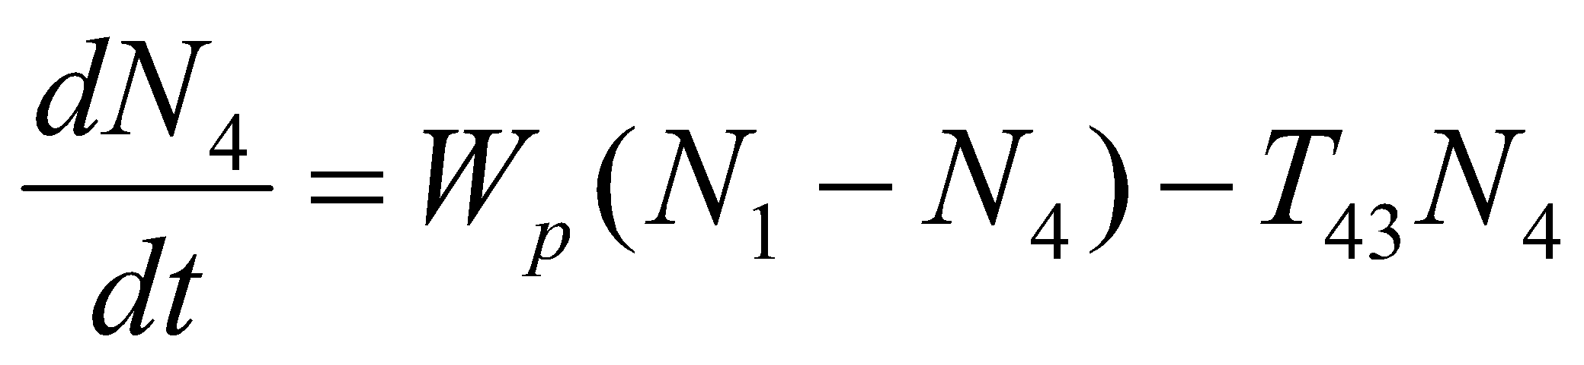
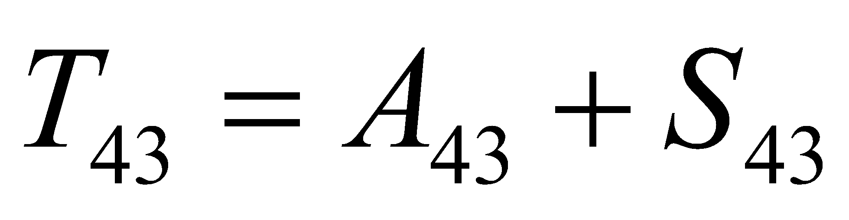

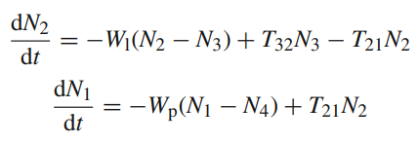
Let N₁,N₂,N₃, and N₄ be the population densities of levels 1, 2, 3, and 4, respectively. The rate of change of N₄ can be written as
where, as before, W_{p}N₁ is the number of atoms being pumped per unit time per unit volume, W_{p}N₄ is the stimulated emission rate per unit volume,
is the relaxation rate from level 4 to level 3 and is the sum of the radiative (A₄₃) and nonradiative (S₄₃) rates. We have neglected (T₄₂) and (T₄₁) in comparison to (T₄₃), i.e., with the assumption that the atoms in level 4 relax to level 3 rather than to levels 2 and 1. Similarly, the rate equation for level 3 may be written as
W₁ represents the stimulated transition rate per atom between levels 3 and 2 and the subscript 1 stands for laser transition; and is a function of I₁; I₁ is the intensity of the radiation at the frequency ν = (E₃ − E₂)/h. Also
T₃₂ = A₃₂ + S₃₂
is the net spontaneous relaxation rate from level 3 to level 2 and consists of the radiative (A₃₂) and the nonradiative (S₃₂) contributions. Again we have neglected any spontaneous transition from level 3 to level 1.
In a similar manner, we can write the rate equations for level 2 and 1
where T21 = A21 + S21 the spontaneous relaxation rate from 2 → 1.
total number of atoms per unit volume in the system
N = N1 + N2 + N3 + N4

Slide 5





Under steady-state conditions
Setting
If the relaxation from level 4 to level 3 is very rapid then T43 >> Wp and hence N4<< N1. The population difference,
Thus in order to be able to obtain population inversion between levels 3 and 2, we must have
T₂₁ > T₃₂
i.e., the spontaneous rate of de-excitation of level 2 to level 1 must be larger than the spontaneous rate of de-excitation of level 3 to level 2. If we now assume T₂₁ >> T₃₂, we obtain
Thus we conclude that even for very small pump rates one can obtain population inversion between levels 3 and 2
Just below threshold for laser oscillation, W_{l} ≈ 0, and hence we obtain
where ΔN = N3 − N2 is the population inversion density.
In a three-level system, there was a minimum pump rate, W_{pt}, required to achieve inversion but in case of four level laser system even for very small pump rates population inversion is possible and maintained between 3 and 2 levels.

Slide 6
